Slide 1
Commodity Price Modeling and Risk Management System for Hedging
Bedant Lohani, Brian Wu, Jake Kostoryz, Olivia Dittrich, Pushkar Patil, Zach Wiebe
December 05, 2025

Slide 2







The Team
Sophia Feng
qfeng5@ncsu.edu

Slide 3
Project Introduction
What it is:
Identify Hard Red Winter (HRW) wheat futures price risk factors
Forecast HRW futures prices
Develop a risk framework to determine the effect of price shocks
Why it matters:
Mitigates financial risk
Data-driven decision making
Supports food security & trade stability
Notes:
What it is:
Identify the factors that impact the price of Kansas Hard Red Winter (HRW) wheat futures
Forecast the prices to understand price behavior and its relationship between different factors
Develop a risk framework to help determine the price shocks and movements to make decisions about the direction of hedging
Why it matters:
Mitigates Financial Risk: Helps stakeholders (e.g. farmers, traders, exporters) hedge against price volatility in HRW wheat futures, protecting margins and ensuring stability
Data-Driven Decision Making: Identifies key market drivers and models price behavior, enabling more informed and timely hedging strategies
Supports Food Security & Trade Stability: Enhances resilience in the agricultural supply chain amid climate risks, geopolitical shifts, and economic uncertainty
What we’ve done:
Completed literature review on understanding the relationship between different factors and the commodity
Collected and cleaned data: USDA, CFTC, market prices, weather patterns
Identified primary risk factors
Developed a modeling framework using a multitude of statistical tests we will discuss in more detail later
Then we did rolling window analysis, hedging strategy design, and result validation with with signal construction and backtesting
Now Jake will walk us through the data in more detail

Slide 4
Project Introduction
What we’ve done:
Literature review
Collected and cleaned data
Identified primary risk factors
Modeling framework
Rolling window analysis
Hedging strategy design
Result validation
Notes:
What it is:
Identify the factors that impact the price of Kansas Hard Red Winter (HRW) wheat futures
Forecast the prices to understand price behavior and its relationship between different factors
Develop a risk framework to help determine the price shocks and movements to make decisions about the direction of hedging
Why it matters:
Mitigates Financial Risk: Helps stakeholders (e.g. farmers, traders, exporters) hedge against price volatility in HRW wheat futures, protecting margins and ensuring stability
Data-Driven Decision Making: Identifies key market drivers and models price behavior, enabling more informed and timely hedging strategies
Supports Food Security & Trade Stability: Enhances resilience in the agricultural supply chain amid climate risks, geopolitical shifts, and economic uncertainty
What we’ve done:
Completed literature review on understanding the relationship between different factors and the commodity
Collected and cleaned data: USDA, CFTC, market prices, weather patterns
Identified primary risk factors
Developed a modeling framework using a multitude of statistical tests we will discuss in more detail later
Then we did rolling window analysis, hedging strategy design, and result validation with with signal construction and backtesting
Now Jake will walk us through the data in more detail

Slide 5
Data Overview
Data Sources:
CME, USDA, CFTC, U.S. Drought Monitor
Timeline: January 1, 2010 to November 1, 2025
Frequency Adjustment: All datasets converted to monthly for alignment and modeling
Data Preprocessing:
Normalized all variables using Yeo-Johnson transformation to handle negative values
Standardized data using z-score to ensure comparable scales
Removed seasonality to focus on main trend
Performed correlation analysis and researched HRW to identify key price drivers

Slide 6
Feature Selection
Supply Condition: Ending_Stocks
Total wheat remaining from previous harvest; indicates supply tightness or surplus and its impact on prices
Positioning: CFTC_Open_Interest_All
Total contracts held by traders; helps gauge market sentiment and trend strength
Trade Flow: Monthly_Exports
Total wheat shipped out; shows demand pressure from exports
Market Structure: Spread_Jul_Sep
Price difference between July and September contracts; reflects hedging behavior and market volatility
Supply Stress: DROUGHT_D2_D4
Measures severe drought conditions affecting crops; impacts potential supply and price risk
Supply Quality: Crop_Condition
Measures the condition of the crop quality - good, poor, excellent

Slide 7
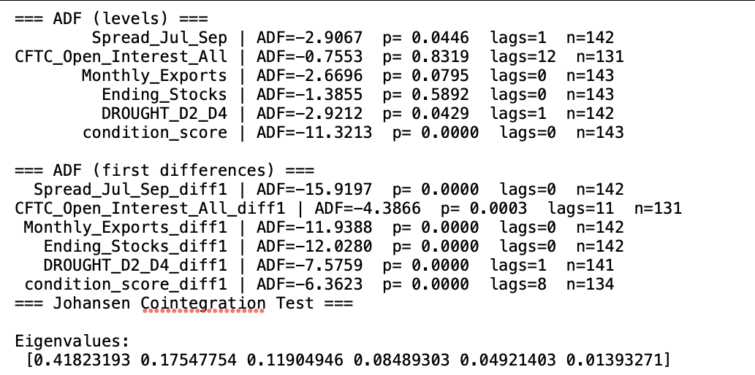
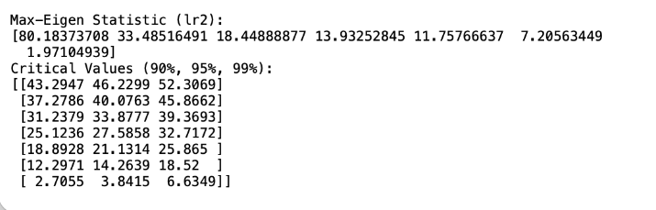
ADF and Johansen Tests

Slide 8
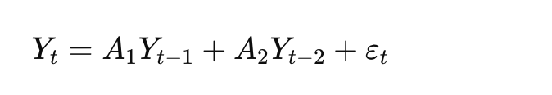
VAR Model
What is VAR:
Model short-run dynamics among all variables using their past values
Model Based:
A VAR(2) selected through lag-selection tests; uses two months of lags
Interpretation:
Captures how shocks move through the system over the next 1-2 months
Results:
Price is highly persistent, and open interest significantly drives short-run price movements

Slide 9
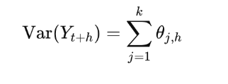
FEVD Model
What is FEVD:
Measures how much each variable’s shocks contribute to the forecast error of price over time
Model Based:
Computed from the impulse response representation of the VAR
Interpretation:
Identifies key drivers of short-run price volatility
Results:
Price variance mainly driven by own shocks, drought shocks, and spread shocks at 60 days

Slide 10
Rolling Window Analysis
Estimate how different observed drivers contribute to price variability and produce factor weights
Parameters:
Rolling Window horizon: 36 months
Time Step: 1 month
FEVD horizon: 12 months
Number of random windows: 200
Steps involved in the analysis:
Fit a VAR model to the selected horizon and compute FEVD
Step forward by 1 month and again fit a VAR model and compute FEVD
Repeat the same for randomly sampled horizons
Compute PCA and proxy-based weights for all the horizons

Slide 11
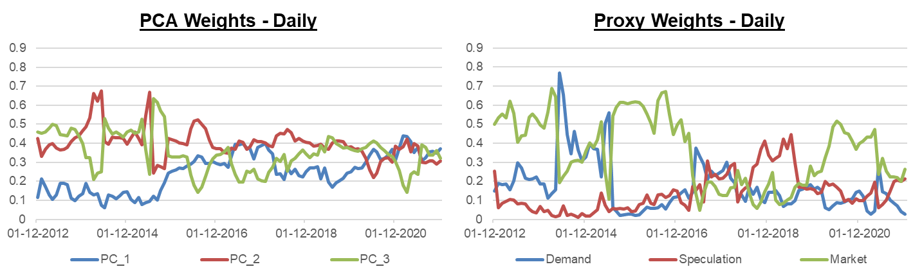
Rolling Window Analysis - Results
Evolution of PCA and Proxy weights over the training horizon

Slide 12
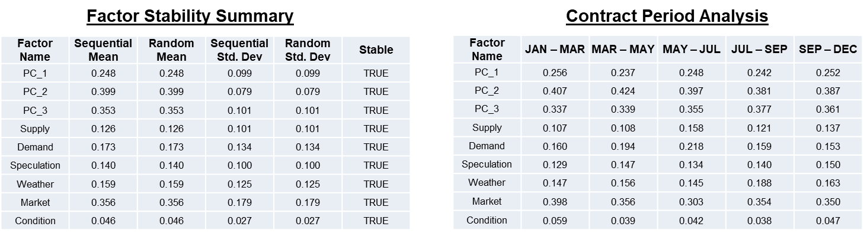
Rolling Window Analysis - Results
Comparison of factor stability and temporal evolution across rolling windows

Slide 13
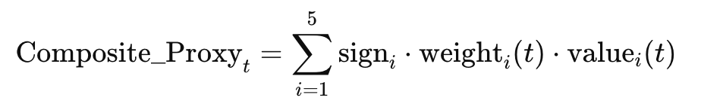
Signal Construction
Goal:
Design and evaluate hedging signals for HRW wheat buyers based on proxy and PCA-based factor signals
Data Used:
HRW wheat price data (monthly)
6 fundamental factors
PCA and Proxy composite weights (Dec 2012 onward) from FEVD
Composite Signal:
Proxy Signal: Weighted sum of standardized factors using interpretable weights
PCA Signal: Multiply rolling PCA weights with static PCA-transformed scores of factor values

Slide 14
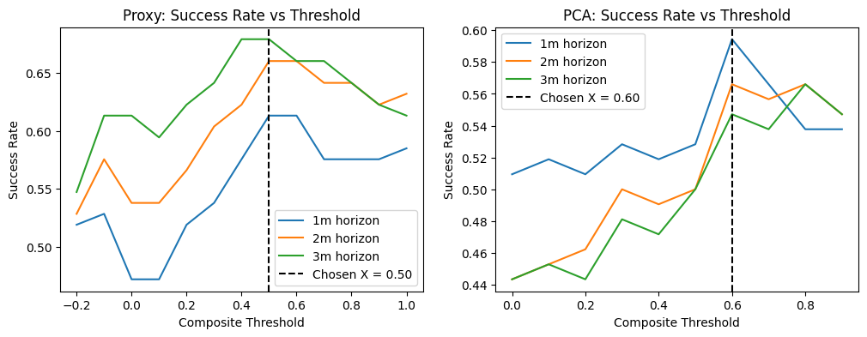
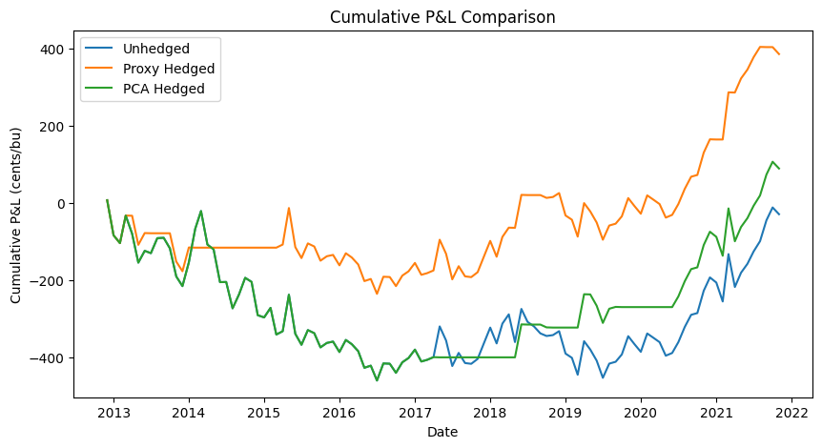
Backtesting

Slide 15
Business Implications
Better Understanding of What Drives HRW Price Risk:
Supply - Ending Stocks
Demand - Exports
Speculation - Open Interest
Weather - Drought
Market - Spread

Slide 16
Business Implications
Dynamic View of Risk
Move from a fixed rule (e.g. always hedge 50%) toward regime-aware hedging guidelines
Set a hedge ratios with a defensible rule (e.g. based on this month’s fundamentals, our model recommends hedging x%)
In drought periods, weather may dominate. Hedging decisions should be more sensitive to those signals

Slide 17
Business Implications
Scenario Planning Around Concrete Drivers
“What if ending stocks jump by 10%?”
“What if USDA cuts export forecasts by 15%?”

Slide 18
Future Works
Enhance the Risk Model & Signal Design
Test non-linear models
Incorporate additional drivers
Scenario & Stress Testing Framework
Shock individual drivers and trace their impact on HRW prices
Design historical and hypothetical stress scenarios (e.g. export ban)
Extension to Other Commodities
Apply the same methodology to other commodities (corn, soybeans, other wheat classes) to build a consistent cross-commodity factor risk framework

Slide 19
Thank you!

Slide 20
The Team
Sophia Feng
qfeng5@ncsu.edu

Slide 21
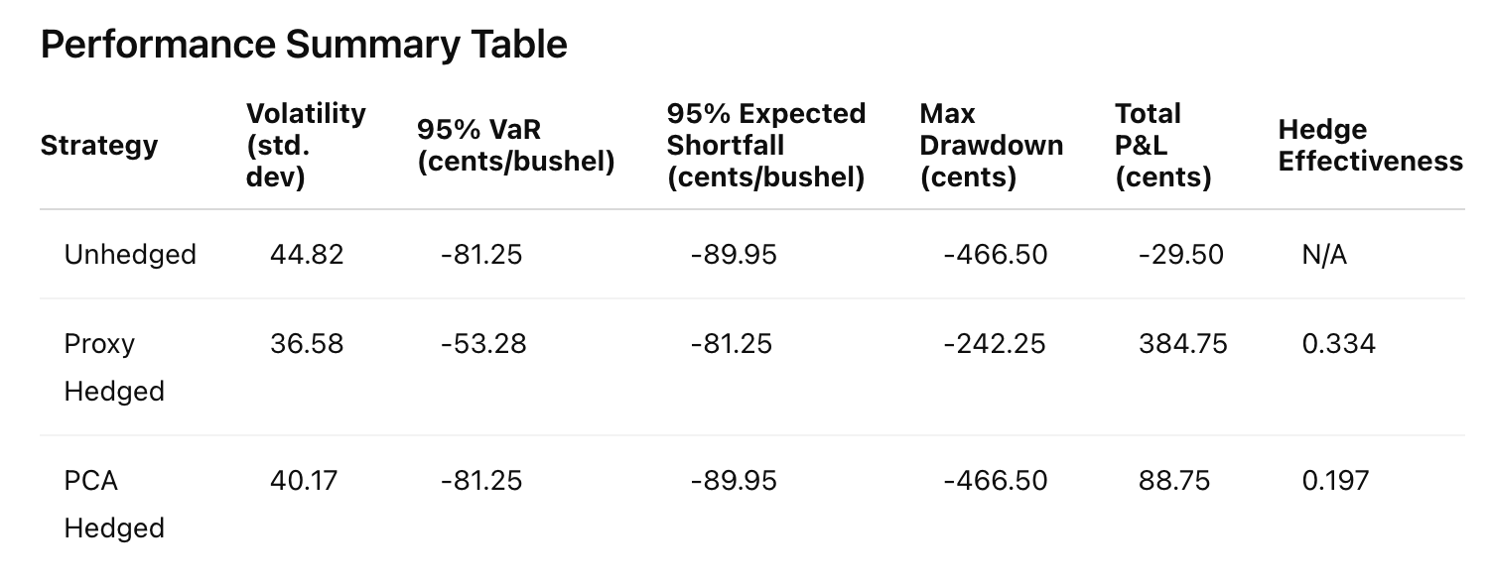
Backtesting
What Was Done:
Backtested two strategies - Proxy and PCA-based composite
Computed price changes at 1, 2, and 3-month horizons for hedging decisions
Set a hedge cost of $0.10/bushel, aligned with the pricing unit (cents/bushel)
Hedging Success:
Proxy Strategy: 66.0% success (2-month horizon)
PCA Strategy: 56.6% success (2-month horizon)

